Slide 1
UNIT - 2 JAVA

Slide 2
Universal Class – Object
Universal super class

Slide 3
The Object Class is known as universal super class of Java.
This is so because Every class you create in Java automatically inherits the Object class.
The Object class is super class of all the classes in Java either directly or Indirectly.
You don't need to extend it manually. All the properties of Object class are already in your class.
You can find the definition of the Object class in java.lang package And there are a few useful methods in this class which you can override in your class.
Following program shows a few method with the examples.

Slide 4
The object class is the super class of all java classes. This class has following important methods.
1)Object clone() :
The clone() method creates a copy of the invoking object and allocates memory to that object.
For example: Banking b1 = new Banking(“MM”,10000);
Banking b2 = b1.clone();
Here b1 is created by new keyword
whereas b2 object created by clone() method. It is a copy of b1 object.

Slide 5
2) Boolean equals(Object obj):
This method is used to compare two objects. It returns true if both object are same.
3) int hashCode():
The hashCode() method returns the hashcode value for an object. This value is unique for every object.

Slide 6
4) Final Class getClass():
This method returns the class information of a class. It returns the class name and the package name of its class.
5) String toString():
It returns the string description of an object.
This method should be overridden by each class to display the object information.

Slide 7
Access Modifiers
The access modifiers in Java specifies the accessibility or scope of a field, method, constructor, or class. We can change the access level of fields, constructors, methods, and class by applying the access modifier on it
There are four types of Java access modifiers:
Private: The access level of a private modifier is only within the class. It cannot be accessed from outside the class.

Slide 8
Default: The access level of a default modifier is only within the package. It cannot be accessed from outside the package. If you do not specify any access level, it will be the default.
Protected: The access level of a protected modifier is within the package and outside the package through child class. If you do not make the child class, it cannot be accessed from outside the package.
Public: The access level of a public modifier is everywhere. It can be accessed

Slide 9
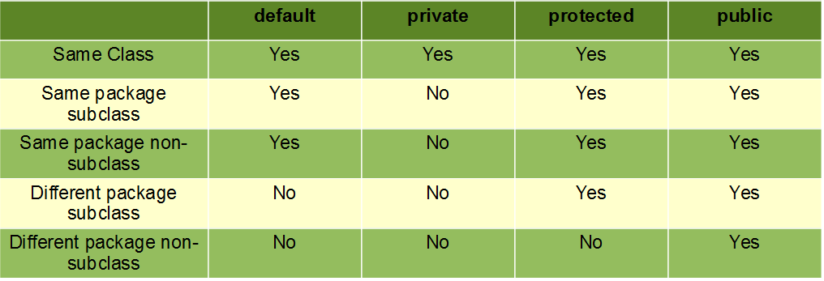

Slide 10
When variables and methods are declared private, they cannot be accessed outside of the class. For example,
class Data {
// private variable
private String name;}
public class Main {
public static void main(String[] main){
// create an object of Data
Data d = new Data();
// access private variable and field from another class
d.name = "Programjava";
}}

Slide 11
In the above example, we have declared a private variable named name. When we run the program, we will get the following error:
Main.java:18: error: name has private access in Data
d.name = "Programjava";
^

Slide 12
Protected Access Modifier
When methods and data members are declared protected, we can access them within the same package as well as from subclasses. For example,
class Animal { // protected method
protected void display() {
System.out.println("I am an animal"); }}
class Dog extends Animal {
public static void main(String[] args) {
// create an object of Dog class
Dog dog = new Dog();
// access protected method
dog.display(); }}

Slide 13
Output:
I am an animal
In the above example, we have a protected method named display() inside the Animal class. The Animal class is inherited by the Dog class.

Slide 14
Public Access Modifier
When methods, variables, classes, and so on are declared public, then we can access them from anywhere. The public access modifier has no scope restriction. For example,
// public class
public class Animal {
// public variable
public int legCount;
// public method
public void display() {
System.out.println("I am an animal.");
System.out.println("I have " + legCount + " legs."); }}

Slide 15
public class Main {
public static void main( String[] args ) {
// accessing the public class
Animal animal = new Animal();
// accessing the public variable
animal.legCount = 4;
// accessing the public method
animal.display();
}
}

Slide 16
Output:
I am an animal.
I have 4 legs.
Here,
The public class Animal is accessed from the Main class.
The public variable legCount is accessed from the Main class.
The public method display() is accessed from the Main class.

Slide 17
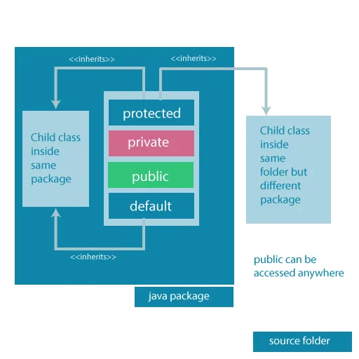

Slide 18
Access modifiers are mainly used for encapsulation. It can help us to control what part of a program can access the members of a class.

Slide 19
Constructors in Inheritance :
Inheritance can be defined as the process where one class acquires the properties (methods and fields) of another. With the use of inheritance the information is made manageable in a hierarchical order.
The class which inherits the properties of other is known as subclass (derived class, child class) and the class whose properties are inherited is known as superclass (base class, parent class).

Slide 20
extends Keyword
extends is the keyword used to inherit the properties of a class. Following is the syntax of extends keyword.
Syntax
class Super {
.....
.....
}
class Sub extends Super {
.....
.....
}

Slide 21
Following is an example demonstrating Java inheritance. In this example, you can observe two classes namely Calculation and My_Calculation.
Using extends keyword, the My_Calculation inherits the methods addition() and Subtraction() of Calculation class.

Slide 22
class Calculation {
int z;
public void addition(int x, int y) {
z = x + y;
System.out.println("The sum of the given numbers:"+z);
}
public void Subtraction(int x, int y) {
z = x - y;
System.out.println("The difference between numbers:"+z);
}
}

Slide 23
public class My_Calculation extends Calculation {
public void multiplication(int x, int y) {
z = x * y;
System.out.println("The product of numbers:"+z);
}
public static void main(String args[]) {
int a = 20, b = 10;
My_Calculation demo = new My_Calculation();
demo.addition(a, b);
demo.Subtraction(a, b);
demo.multiplication(a, b);
}
}

Slide 24
Output
The sum of the given numbers:30
The difference between the given numbers:10
The product of the given numbers:200
In the given program, when an object to My_Calculation class is created, a copy of the contents of the superclass is made within it. That is why, using the object of the subclass you can access the members of a superclass.

Slide 25
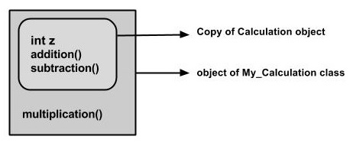
The Superclass reference variable can hold the subclass object, but using that variable you can access only the members of the superclass, so to access the members of both classes it is recommended to always create reference variable to the subclass.
If you consider the above program, you can instantiate the class as given below. But using the superclass reference variable ( cal in this case) you cannot call the method multiplication(), which belongs to the subclass My_Calculation.
Calculation demo = new My_Calculation();
demo.addition(a, b);
demo.Subtraction(a, b);

Slide 26
Note − A subclass inherits all the members (fields, methods, and nested classes) from its superclass. Constructors are not members, so they are not inherited by subclasses, but the constructor of the superclass can be invoked from the subclass.
The super keyword
The super keyword is similar to this keyword. Following are the scenarios where the super keyword is used.
It is used to differentiate the members of superclass from the members of subclass, if they have same names.
It is used to invoke the superclass constructor from subclass.

Slide 27
Differentiating the Members
If a class is inheriting the properties of another class. And if the members of the superclass have the names same as the sub class, to differentiate these variables we use super keyword as shown below.
super.variable
super.method();

Slide 28
In the given program, you have two classes namely Sub_class and Super_class, both have a method named display() with different implementations, and a variable named num with different values. We are invoking display() method of both classes and printing the value of the variable num of both classes. Here you can observe that we have used super keyword to differentiate the members of superclass from subclass.

Slide 29
class Super_class {
int num = 20;
// display method of superclass
public void display() {
System.out.println("display method of superclass");
}
}
public class Sub_class extends Super_class {
int num = 10;
// display method of sub class
public void display() {
System.out.println("display method of subclass");
}

Slide 30
public void my_method() {
// Instantiating subclass
Sub_class sub = new Sub_class();
// Invoking the display() method of sub class
sub.display();
// Invoking the display() method of superclass
super.display();
// printing the value of variable num of subclass
System.out.println("variable named num in sub class:"+ sub.num);
// printing the value of variable num of superclass
System.out.println("variable named num in super class:"+ super.num);
}

Slide 31
public static void main(String args[])
{
Sub_class obj = new Sub_class();
obj.my_method();
}
}
Output
display method of subclass
display method of superclass
variable named num in sub class:10
variable named num in super class:20

Slide 32
Invoking Superclass Constructor:
If a class is inheriting the properties of another class, the subclass automatically acquires the default constructor of the superclass. But if you want to call a parameterized constructor of the superclass, you need to use the super keyword as shown below.
super(values);

Slide 33
The program given in this section demonstrates how to use the super keyword to invoke the parameterized constructor of the superclass. This program contains a superclass and a subclass, where the superclass contains a parameterized constructor which accepts a integer value, and we used the super keyword to invoke the parameterized constructor of the superclass.

Slide 34
class Superclass {
int age;
Superclass(int age) {
this.age = age;
}
public void getAge() {
System.out.println("The value of the variable named age in super class is: " +age);
}
}

Slide 35
public class Subclass extends Superclass {
Subclass(int age) {
super(age);
}
public static void main(String args[]) {
Subclass s = new Subclass(24);
s.getAge();
}
}
Output
The value of the variable named age in super class is: 24

Slide 36
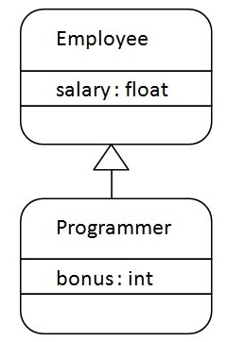
Example :Programmer is the subclass and Employee is the superclass. The relationship between the two classes is Programmer IS-A Employee. It means that Programmer is a type of Employee.
class Employee{
float salary=40000; }
class Programmer extends Employee{
int bonus=10000;
public static void main(String args[]){
Programmer p=new Programmer();
System.out.println("Programmer salary is:"+p.salary);
System.out.println("Bonus of Programmer is:"+p.bonus);
}
}
Output :
Programmer salary is:40000.0
Bonus of programmer is:10000

Slide 37
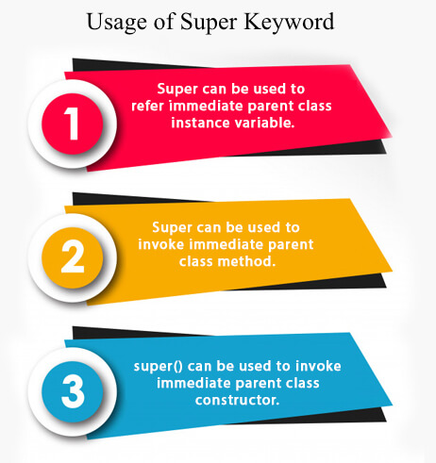

Slide 38
Example :
Emp class inherits Person class so all the properties of Person will be inherited to Emp by default. To initialize all the property, we are using parent class constructor from child class. In such way, we are reusing the parent class constructor.
class Person{
int id;
String name;
Person(int id,String name){
this.id=id;
this.name=name;
} }

Slide 39
class Emp extends Person{
float salary;
Emp(int id,String name,float salary){
super(id,name);//reusing parent constructor
this.salary=salary; }
void display(){System.out.println(id+" "+name+" "+salary);} }
class TestSuper5{
public static void main(String[] args){
Emp e1=new Emp(1,"ankit",45000f);
e1.display();
}}
Output:
1 ankit 45000

Slide 40
Default Constructor in Java
class Student
{
String name;
Double gpa;
}
public class Main
{
public static void main(String[] args)
{
Student s = new Student();
System.out.println(s.name + "\t" + s.gpa);
}
}
Output:
null null

Slide 41
For example, consider the Student class shown below with two attributes: student name and GPA. A constructor is defined for the class, which takes a string name and a double GPA as parameters and initializes the corresponding attributes for the new object.
Parameterized Constructor in Java
class Student
{
String name;
Double gpa;
Student(String s, Double g)
{
name = s;
gpa = g; }}
public class Main
{
public static void main(String[] args)
{
Student s = new Student("Justin", 9.75);
System.out.println(s.name + "\t" + s.gpa); }}
Output:
Justin 9.75

Slide 42
Constructor Overloading in Java
Output:
Justin null
Jessica 9.23
class Student
{
String name;
Double gpa;
Student(String s, Double g)
{
name = s;
this.gpa = g; }
Student(String s) {
name = s;
gpa = null;//Setting GPA to null
}}
public class Main{
public static void main(String[] args) {
Student s1 = new Student("Justin");
Student s2 = new Student("Jessica", 9.23);
System.out.println(s1.name + "\t" + s1.gpa);
System.out.println(s2.name + "\t" + s2.gpa);
}}

Slide 43
Remember that Java provides a default constructor only when no other constructor is created for a class. But for our class, constructors already exist, and so we need to create a default constructor.
class Student
{
String name;
Double gpa;
Student(String s, Double g)
{
name = s;
gpa = g;
}
Student(String s)
{
name = s;
gpa = null;
}
Student() {
name = null;
gpa = null;
}}
public class Main{
public static void main(String[] args)
{ Student s1 = new Student();
Student s2 = new Student("Justin");
Student s3 = new Student("Jessica", 9.23);
System.out.println(s1.name + "\t" + s1.gpa);
System.out.println(s2.name + "\t" + s2.gpa);
System.out.println(s3.name + "\t" + s3.gpa);
}}
Output:
null null
Justin null
Jessica 9.23

Slide 44
Method Overriding
If subclass (child class) has the same method as declared in the parent class, it is known as method overriding in Java.
Overriding is a feature that allows a subclass or child class to provide a specific implementation of a method that is already provided by one of its super-classes or parent classes. When a method in a subclass has the same name, same parameters or signature, and same return type(or sub-type) as a method in its super-class, then the method in the subclass is said to override the method in the super-class.

Slide 45
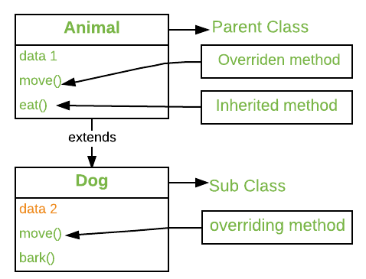

Slide 46
Method overriding is one of the way by which java achieve Run Time Polymorphism.The version of a method that is executed will be determined by the object that is used to invoke it. If an object of a parent class is used to invoke the method, then the version in the parent class will be executed, but if an object of the subclass is used to invoke the method, then the version in the child class will be executed. In other words, it is the type of the object being referred to (not the type of the reference variable) that determines which version of an overridden method will be executed.

Slide 47
// A Simple Java program to demonstrate
// method overriding in java
// Base Class
class Parent {
void show()
{
System.out.println("Parent's show()");
}
}

Slide 48
// Inherited class
class Child extends Parent {
// This method overrides show() of Parent
@Override
void show()
{
System.out.println("Child's show()");
}
}

Slide 49
class Main {
public static void main(String[] args){
// If a Parent type reference refers
// to a Parent object, then Parent's
// show is called
Parent obj1 = new Parent();
obj1.show();
// If a Parent type reference refers
// to a Child object Child's show()
// is called. This is called RUN TIME
// POLYMORPHISM.
Parent obj2 = new Child();
obj2.show(); }}
Output:
Parent's show()
Child's show()

Slide 50
Usage of Java Method Overriding
Method overriding is used to provide the specific implementation of a method which is already provided by its superclass.
Method overriding is used for runtime polymorphism

Slide 51
Rules for Java Method Overriding
The method must have the same name as in the parent class
The method must have the same parameter as in the parent class.
There must be an IS-A relationship (inheritance).

Slide 52
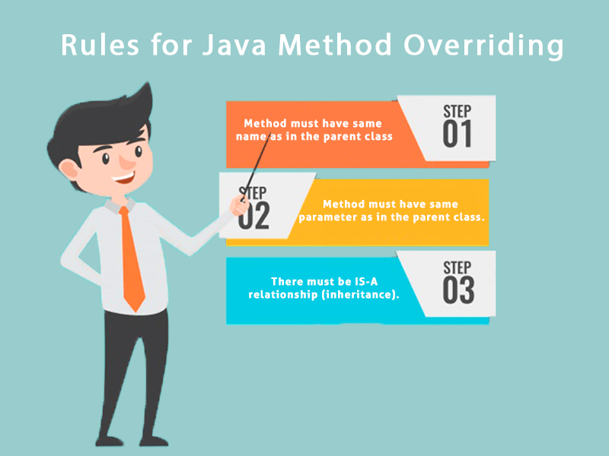

Slide 53
Understanding the problem without method overridingLet's understand the problem that we may face in the program if we don't use method overriding.
class Vehicle{
void run(){System.out.println("Vehicle is running");}
}

Slide 54
class Bike extends Vehicle{
public static void main(String args[]){
//creating an instance of child class
Bike obj = new Bike();
//calling the method with child class instance
obj.run();
}
}
O/P:
Vehicle is running

Slide 55
In this example, we have defined the run method in the subclass as defined in the parent class but it has some specific implementation.
//Java Program to illustrate the use of Java Method Overriding
class Vehicle{
//defining a method
void run(){System.out.println("Vehicle is running");} }
class Bike2 extends Vehicle{
//defining the same method as in the parent class
void run(){System.out.println("Bike is running safely");}

Slide 56
public static void main(String args[]){
Bike2 obj = new Bike2();//creating object
obj.run();//calling method
}
}
Output:
Bike is running safely

Slide 57
Consider a scenario where Bank is a class that provides functionality to get the rate of interest. However, the rate of interest varies according to banks. For example, SBI, ICICI and AXIS banks could provide 8%, 7%, and 9% rate of interest.

Slide 58
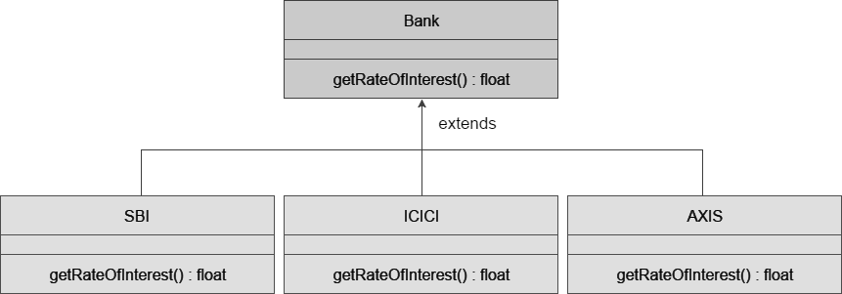

Slide 59
class Bank{
int getRateOfInterest(){return 0;}
}
//Creating child classes.
class SBI extends Bank{
int getRateOfInterest(){return 8;}
}
class ICICI extends Bank{
int getRateOfInterest(){return 7;}
}

Slide 60
class AXIS extends Bank{
int getRateOfInterest(){return 9;} }
class Test2{
public static void main(String args[]){
SBI s=new SBI();
ICICI i=new ICICI();
AXIS a=new AXIS();
System.out.println("SBI Rate of Interest: "+s.getRateOfInterest());
System.out.println("ICICI Rate of Interest: "+i.getRateOfInterest());
System.out.println("AXIS Rate of Interest: "+a.getRateOfInterest());
} }
Output:
SBI Rate of Interest: 8
ICICI Rate of Interest: 7
AXIS Rate of Interest: 9

Slide 61
Method Overriding and Dynamic Method Dispatch
Method Overriding is an example of runtime polymorphism. When a parent class reference points to the child class object then the call to the overridden method is determined at runtime, because during method call which method(parent class or child class) is to be executed is determined by the type of object. This process in which call to the overridden method is resolved at runtime is known as dynamic method dispatch.

Slide 62
class ABC{
//Overridden method
public void disp()
{
System.out.println("disp() method of parent class");
}
}
class Demo extends ABC{
//Overriding method
public void disp(){
System.out.println("disp() method of Child class");
}
public void newMethod(){
System.out.println("new method of child class");
}

Slide 63
public static void main( String args[]) {
/* When Parent class reference refers to the parent class object
* then in this case overridden method (the method of parent class)
* is called. */
ABC obj = new ABC();
obj.disp();
/* When parent class reference refers to the child class object
* then the overriding method (method of child class) is called.
* This is called dynamic method dispatch and runtime polymorphism
*/
ABC obj2 = new Demo();
obj2.disp();
}}
Output:
disp() method of parent class
disp() method of Child class

Slide 64
Super keyword in Method Overriding
The super keyword is used for calling the parent class method/constructor. super.myMethod() calls the myMethod() method of base class while super() calls the constructor of base class.

Slide 65
class ABC{
public void myMethod()
{
System.out.println("Overridden method");
}
}
class Demo extends ABC{
public void myMethod(){
//This will call the myMethod() of parent class
super.myMethod();
System.out.println("Overriding method");
}
public static void main( String args[]) {
Demo obj = new Demo();
obj.myMethod();
}
}
Output:
Class ABC: mymethod()
Class Test: mymethod()

Slide 66
Program to illustrate the use of method overriding in multilevel inheritance in Java:
class GrandFather {
void move() {
System.out.println("I use my stick to move!"); }}
class Father extends GrandFather {
void move() {
System.out.println("I can walk fast!");
}}

Slide 67
class Baby extends Father {
void move() {
System.out.println("I crawl and have fun!");
}
public static void main(String[] args) {
GrandFather ob = new Baby();
ob.move();
}
}
Output:
I crawl and have fun!

Slide 68
NOTE : static, final, and private access restrict the method from overriding. This means that any parent class method which has a private access specifier or is static or final in nature cannot be overridden by any of its child classes.

